Slide 1

The Impact of Age Demographics on Maryland’s Economic and Tax Revenue Outlook
Andrew Schaufele: Director, Bureau of Revenue Estimates

Slide 2
How We Added Value
Initial Mission: Quantify the tax impact from the shifting age composition within our tax base
Able to attach birthdates to our tax filing database
Separated jointly filed returns into individuals
  Split income evenly
Provides an accurate database for the Maryland population – real data, no surveys or extrapolation
Product is not a sample, every table and summary is derived from the full Maryland tax filing population
Caveats – missing those that don’t file but earn income and use population estimates for certain metrics

Slide 3
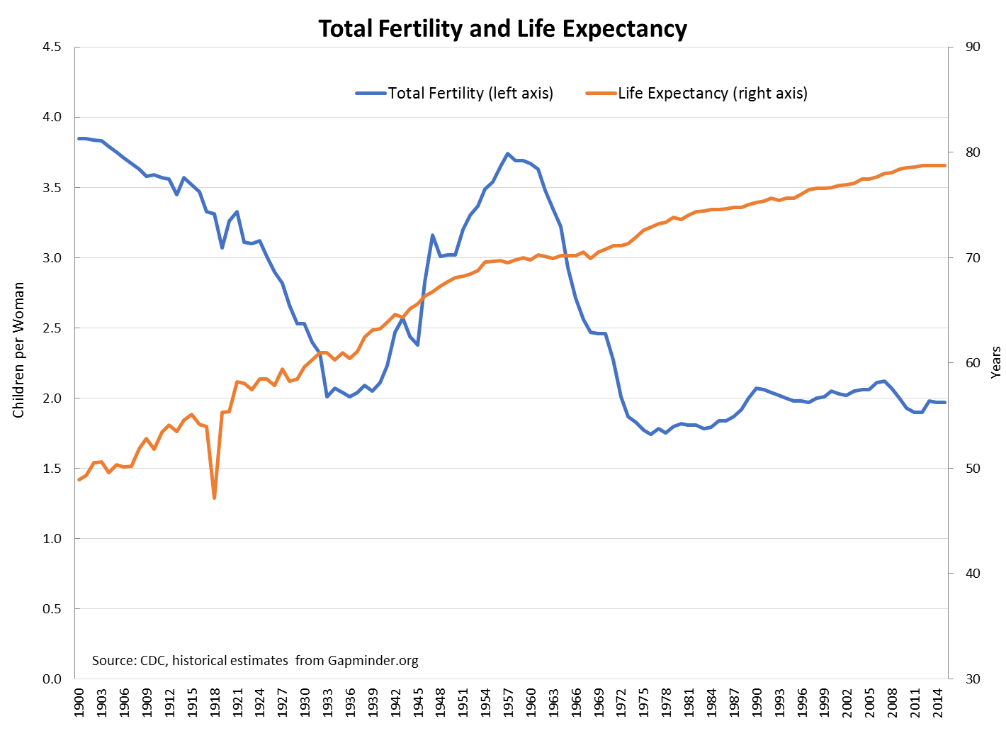
Creation of the Boom

Slide 4
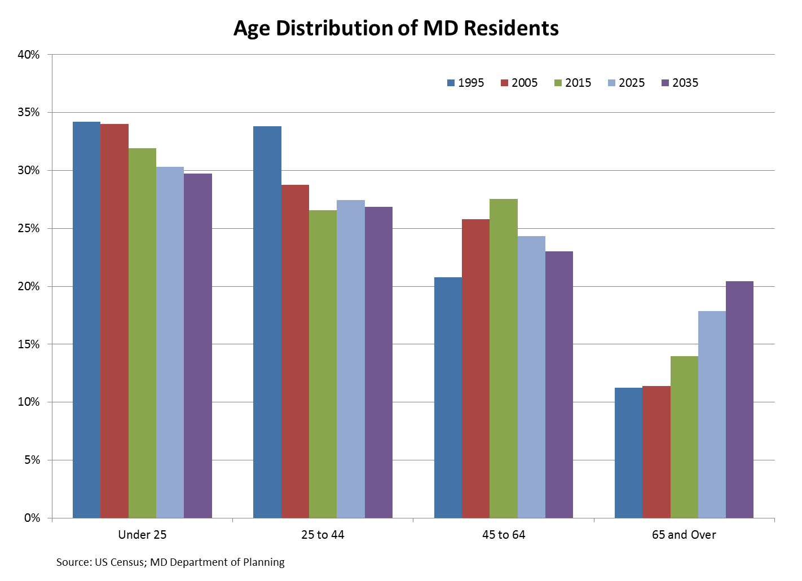
Nation and MD are Aging

Slide 5
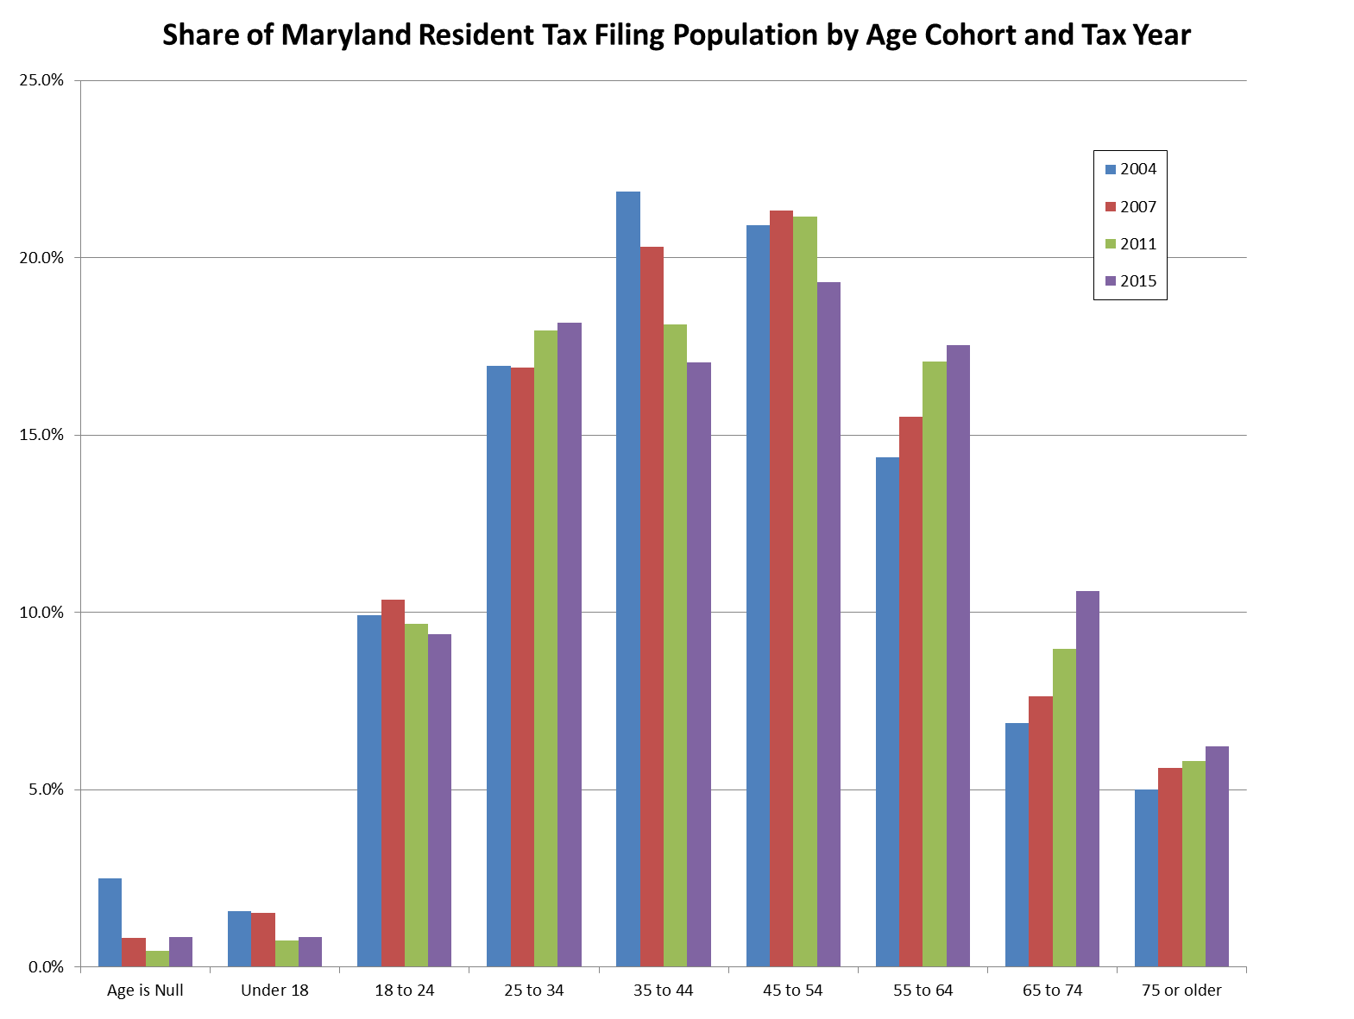
Similar Pattern for Tax Filing Population

Slide 6
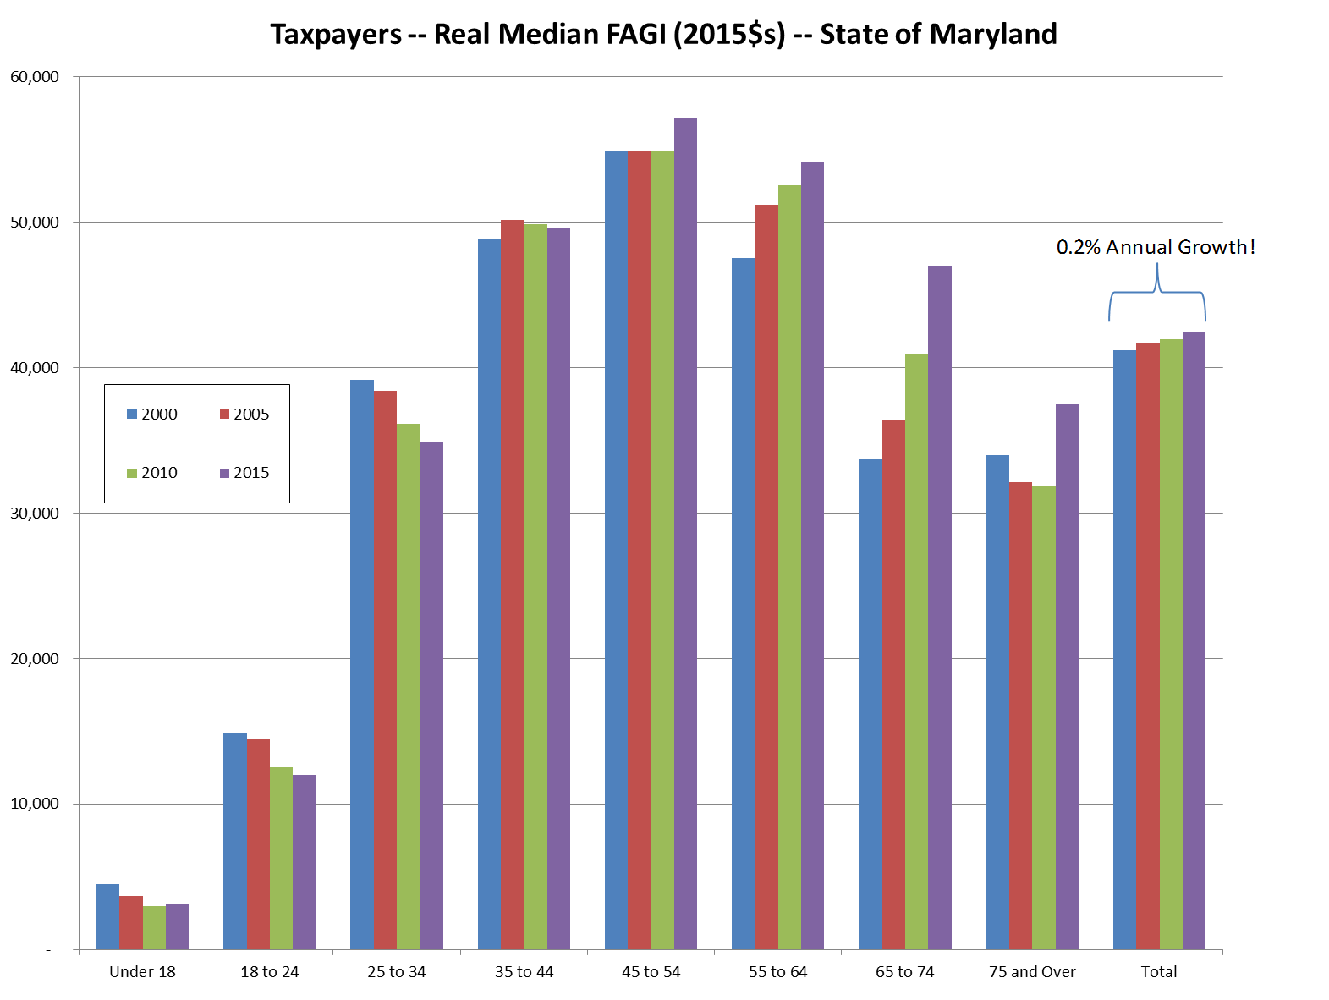
Most Productive Age Cohort Shrinking
Largest Earners Declining as Share of Total

Slide 7
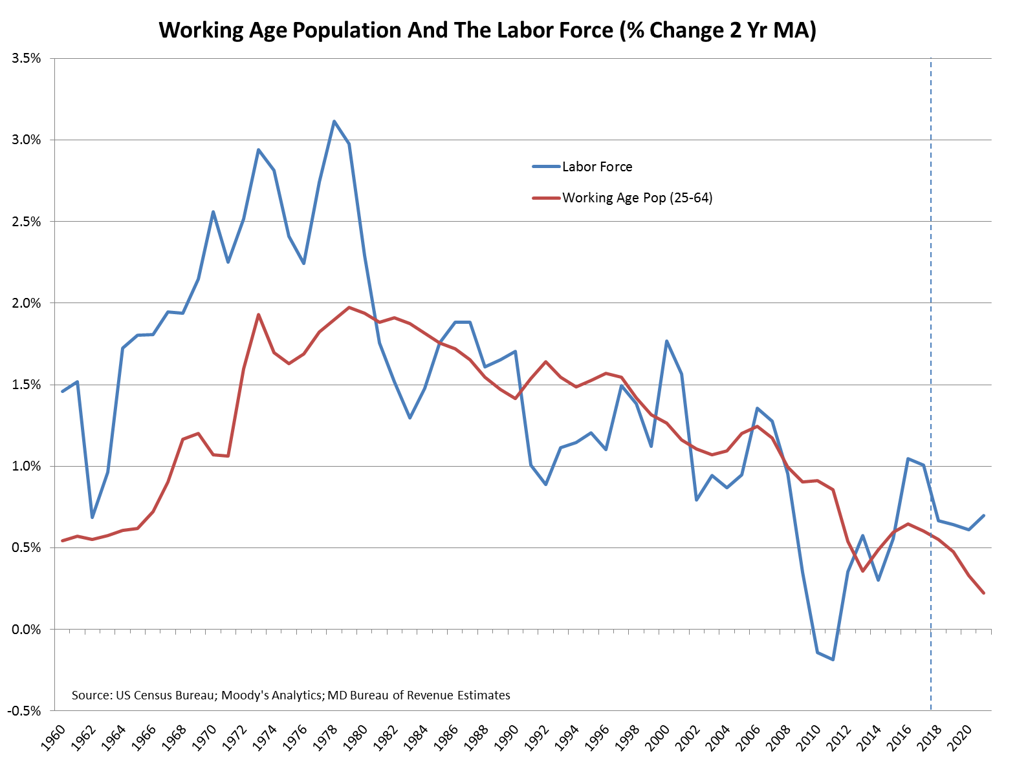
Slow Working Age Population Growth Saps Labor Force

Slide 8
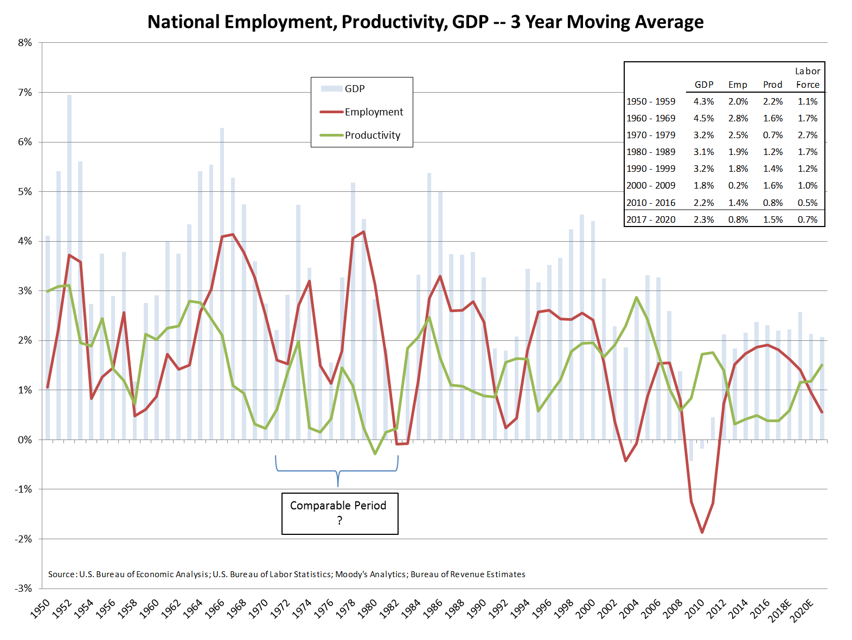
Slow Working Age Population Growth Saps Labor Force

Slide 9
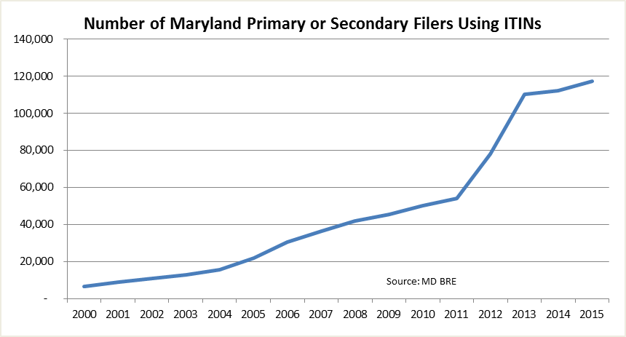
Immigration
With no immigration since 1965*:
  US population in 2015 would be 252 million rather than 324 million
  Median age 41 rather than 38
With no immigration after 2015*:
  US population in 2065 would be 338 million and shrinking rather than 441 million and growing

Slide 10
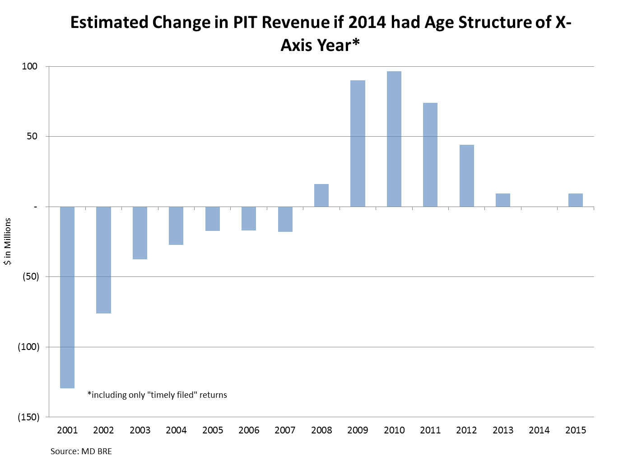
Significant Impact on Revenues Already
Costing ~ $100M already per year, 1.5% of PIT revenues
Negative impact to grow annually, by 2035 costing ~ $300M per year (today’s dollars), a 4.5% reduction in PIT revenues

Slide 11
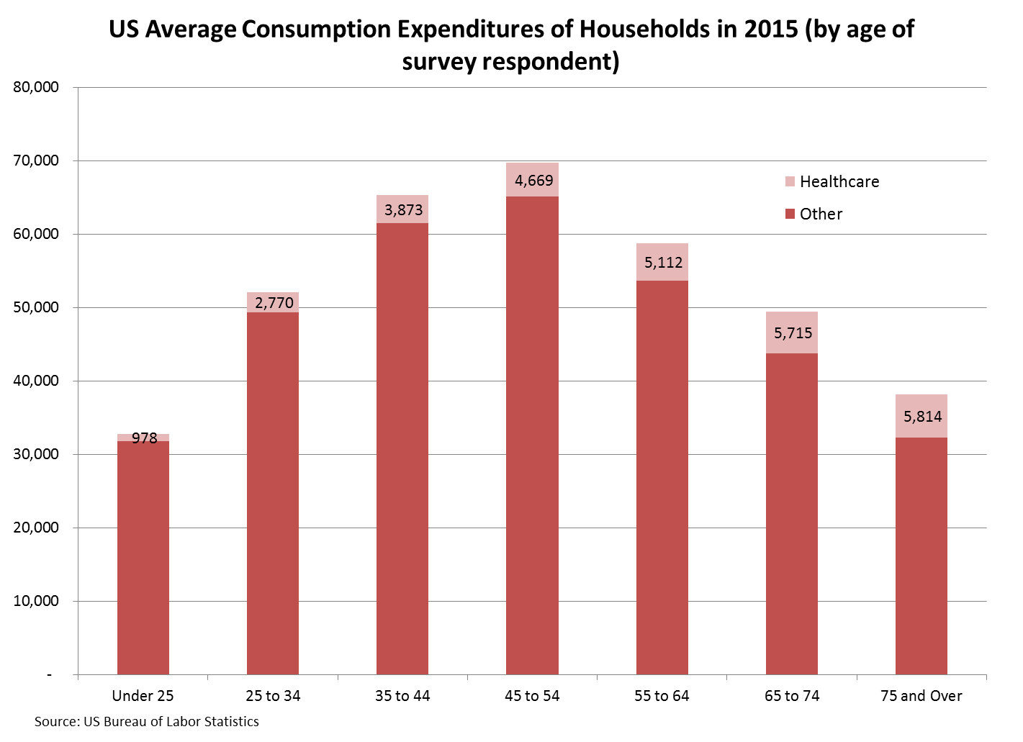
Impacts Sales Tax Also

Slide 12
Uncovered Problem – Taxpayer Participation Rate (TPR)
TPR = % of the population that files a tax return
  Joint filers are divided into individuals, income split evenly
For Example:
  Number of Filers = 80
  Population = 100
  Therefore, TPR is 80% (80/100)
Rate falling since 2007, no sign of abating through most recent data (2015)
Further reduction in revenues – On top of slowing and aging workforce
Bigger problem than revenues – tax participation symbolizes participation in society!

Slide 13
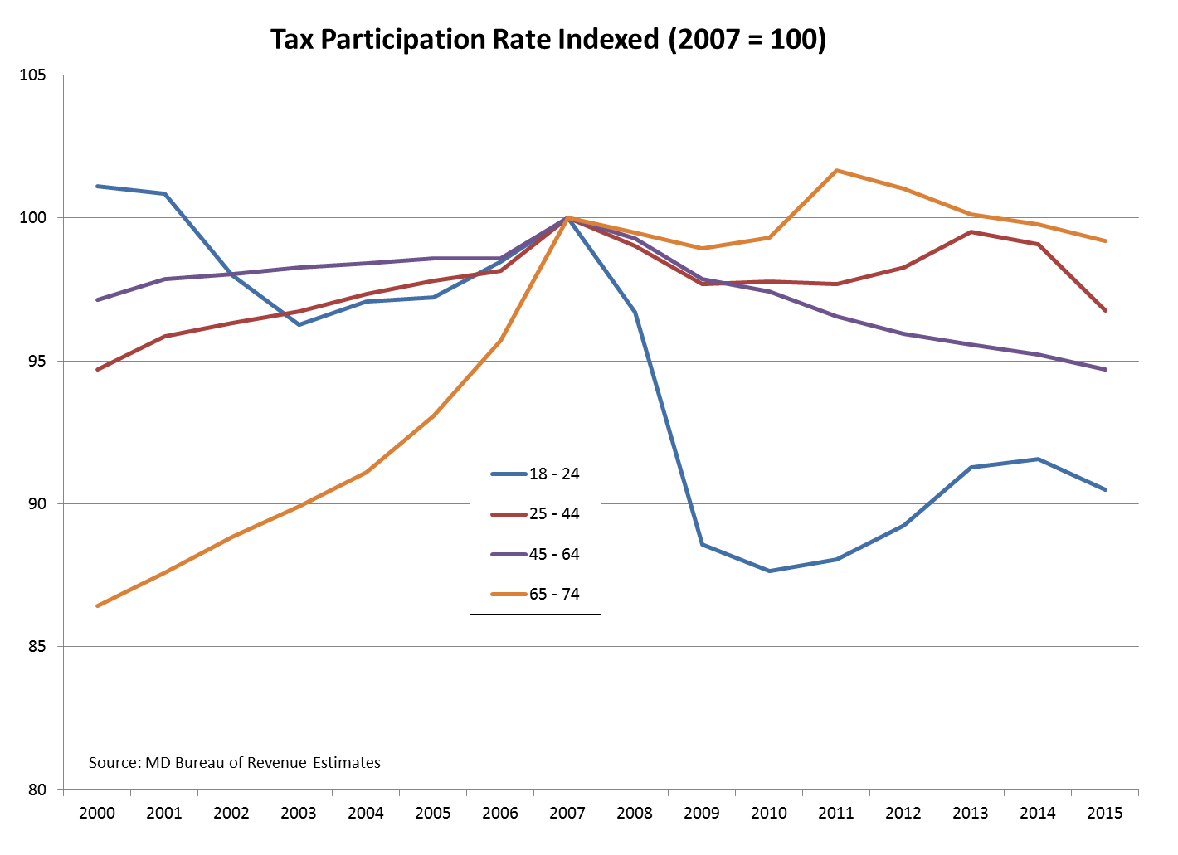
TPR – Indexed to 2007

Slide 14
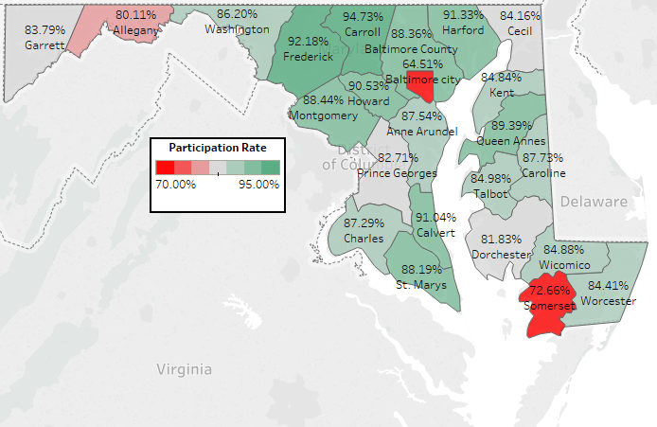
TY 2007 TPR – 45 to 64

Slide 15
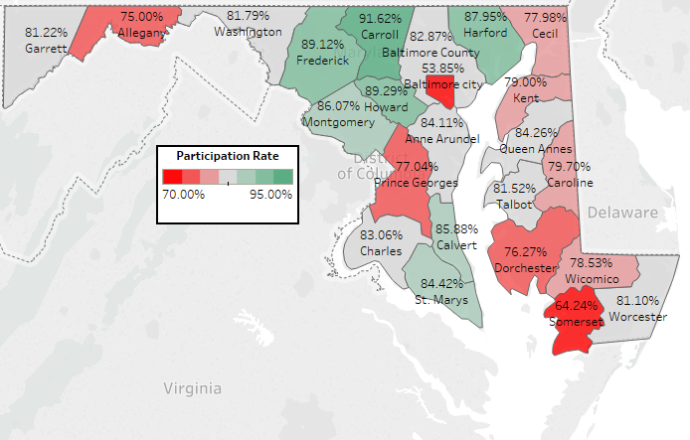
TY 2015 TPR – 45 to 64

Slide 16
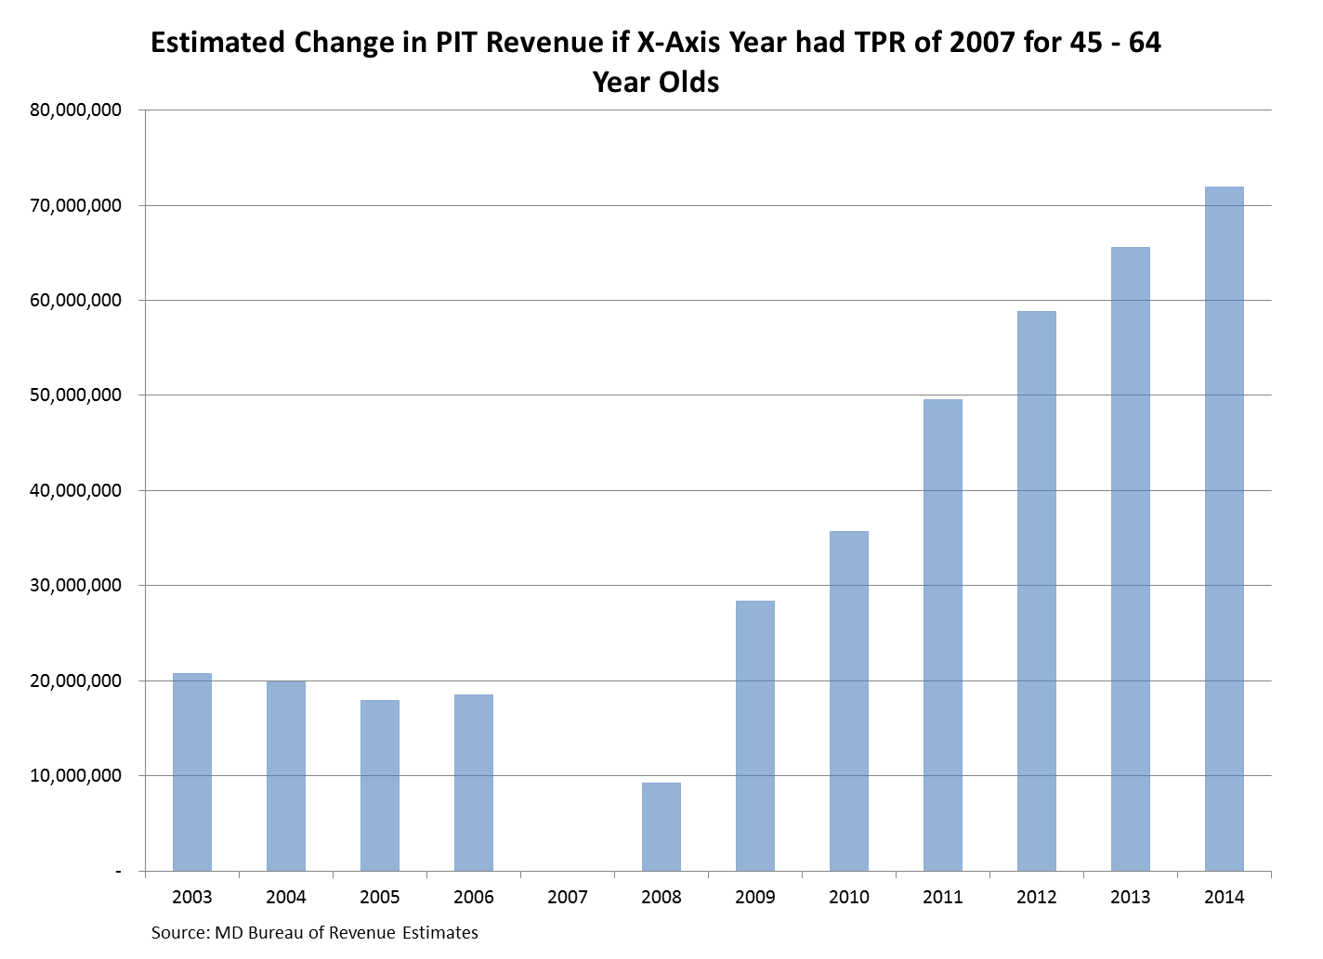
Conservative Estimate for TPR Impact (45-64)
Avg Inc for irregular filers is $37k, 25% less regular filers
# irregular filers decreasing over time, becoming non-filers

